Slide 1

Breast cancer Report

Slide 2

Understanding the data
We found that there was one column with a significant number of missing values. In fact, almost all the entries in that column were missing. Because this column was essentially empty and wouldn't provide any useful information for our analysis, I made the decision to remove it from the dataset. This is similar to discarding a test result that wasn't performed on almost any patient – it wouldn't help us understand the overall picture.
So, in summary, before we started visualizing anything, the main preprocessing step was to clean up the data by removing a column that was almost entirely empty. This ensures we are working with complete and relevant information for the subsequent analysis

Slide 3
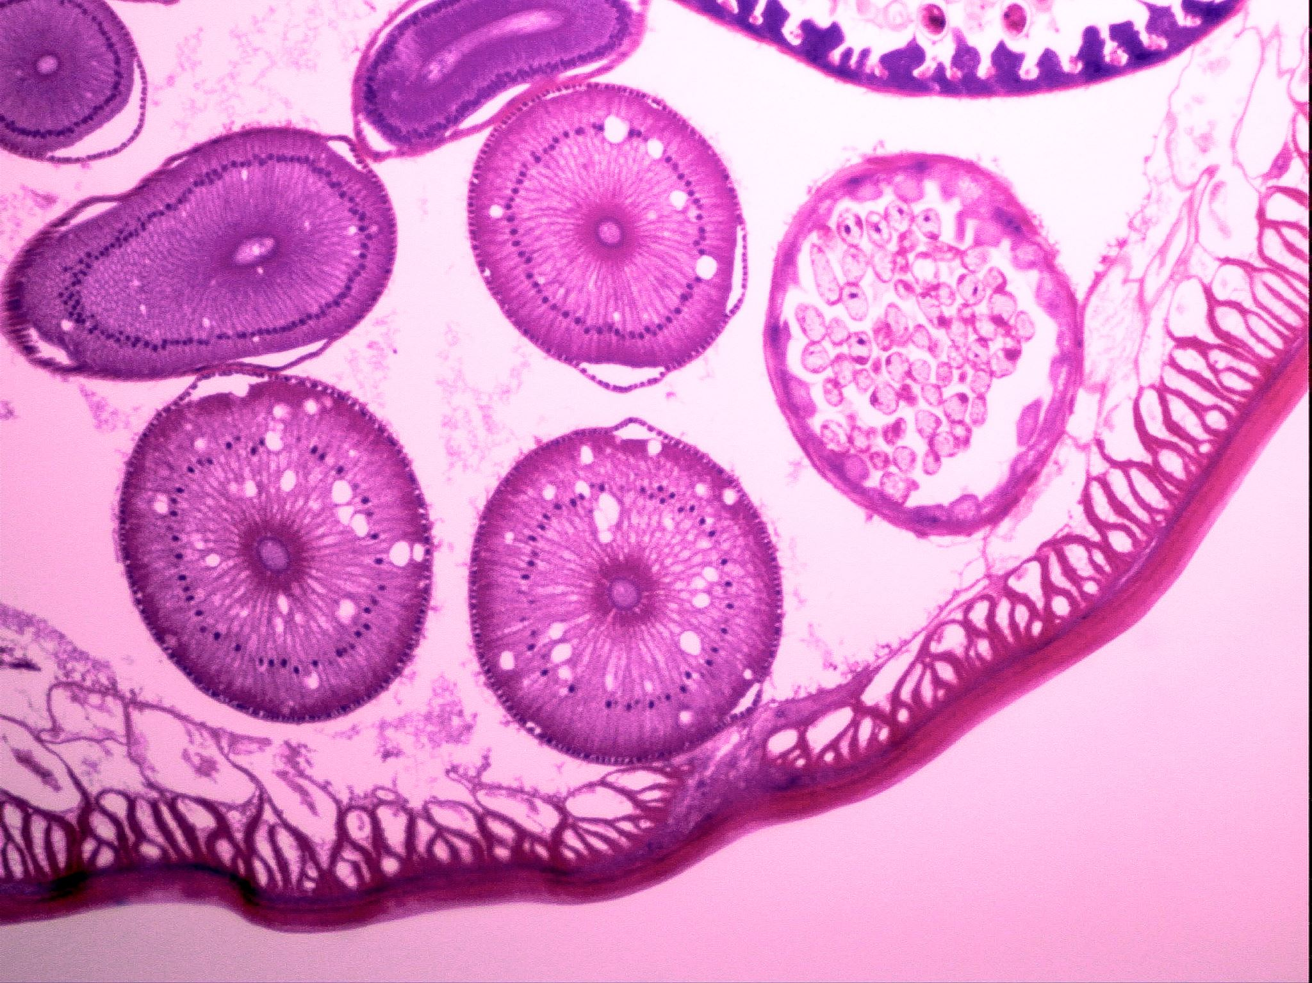
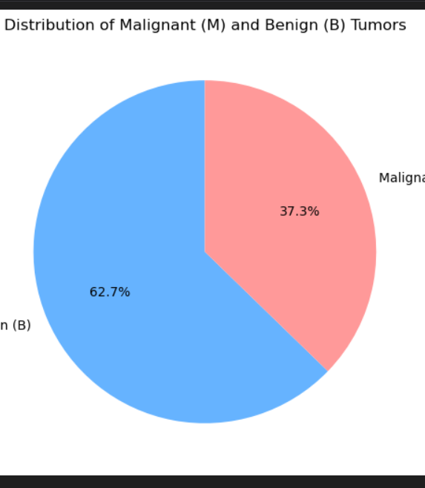
🔍Distribution of Malignant (M) and Benign (B) Tumors
It visualizes how many patient tumor records are malignant (cancerous) vs. benign (non-cancerous) in your dataset.
Blue (Benign B): Represents 62.7% of the total cases. These are non-cancerous tumors, meaning the majority of patients in this dataset have tumors that are not harmful or do not spread.
Red (Malignant M): Represents 37.3% of the cases. These are cancerous tumors, which can grow and spread to other parts of the body.

Slide 4

👩‍⚕️ Why This Matters for You as a Doctor
The chart gives you a quick overview of the prevalence of malignant tumors in your patient data.
It tells you that while most patients have benign tumors, over a third have malignant ones — which is still a significant number, and potentially life-threatening.
This initial insight helps guide further analysis: For example, you might ask:
“Are there patterns or measurements that help us predict whether a tumor is likely to be malignant?”

Slide 5
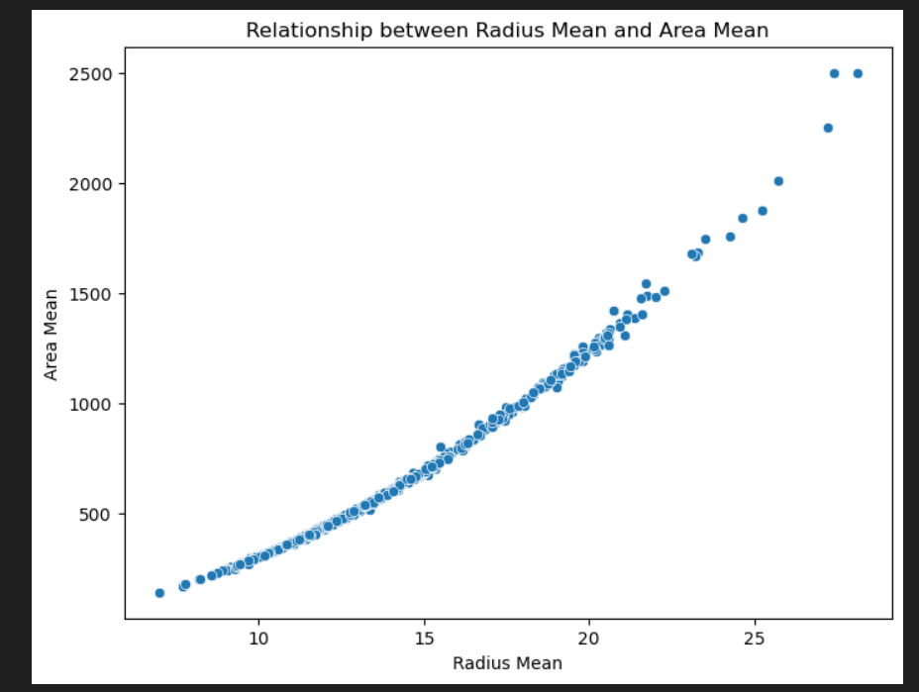
🔍 What You Can Observe
There is a clear, strong positive correlation: As the radius increases, the area also increases — and not just linearly, but more exponentially or quadratically.
This makes sense medically and mathematically: The area of a circular object is proportional to the square of its radius (Area ∝ Radius²), so this curved upward trend is expected.

Slide 6

👩‍⚕️ As a Doctor, What Does This Mean?
Larger tumors (in terms of radius) tend to have a significantly larger area.
From a diagnostic point of view, this is useful because:
It confirms that measurements are consistent — larger radii should result in larger areas.
If a tumor has an unusually large area for a small radius (or vice versa), it could be an anomaly worth investigating.
This kind of relationship might help build predictive models or early detection systems — for example, if radius can be measured quickly, area can be estimated, and that can assist in triaging cases.

Slide 7
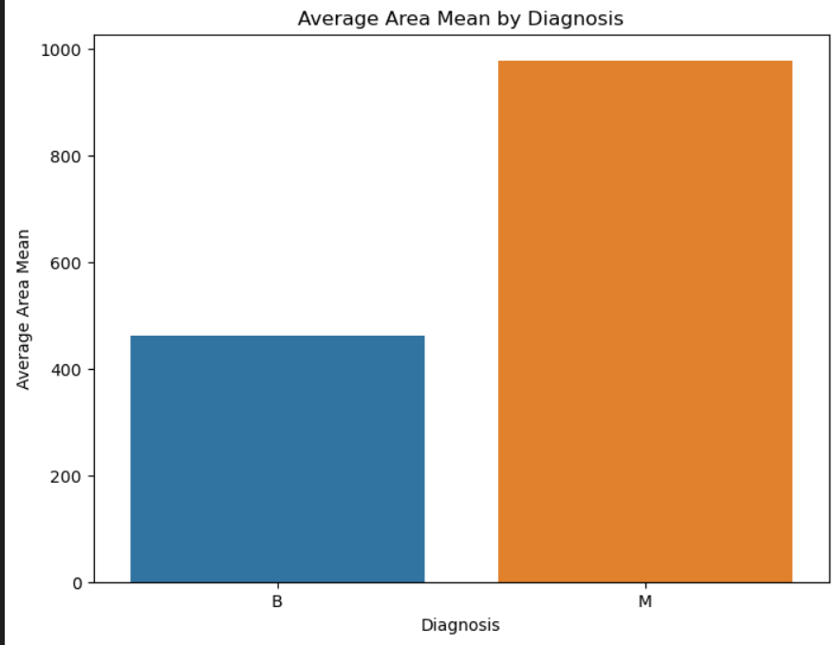
🔍 What You Can Observe
Malignant (M) tumors have a much higher average area than Benign (B) tumors.
Malignant: nearly 1000
Benign: around 470
There’s a clear size difference — on average, malignant tumors are more than twice as large as benign ones in terms of area.

Slide 8
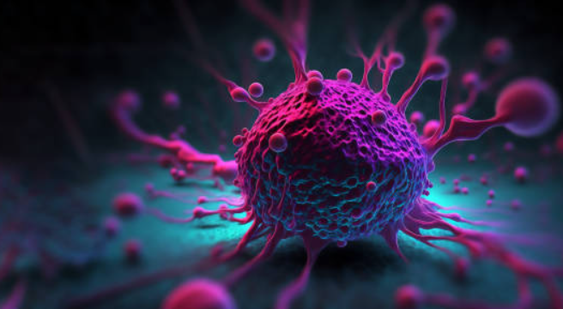
👩‍⚕️ What Does This shows?
"Larger tumor area is strongly associated with malignancy."
This tells you:
Tumor area is a powerful feature for distinguishing between benign and malignant tumors.
If you encounter a tumor with a high area mean, it should raise a red flag for possible malignancy.
This finding supports the idea of using tumor area as a screening indicator during early diagnosis.

Slide 9
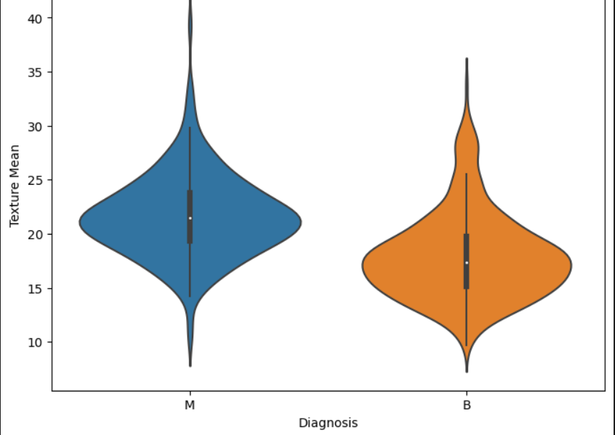
📊Distribution of Texture Mean by Diagnosis
Malignant tumors (blue) tend to have higher texture mean values, with a wider spread and higher density around the upper range.
Benign tumors (orange) show a lower texture mean, with a tighter distribution and fewer high-value outliers.
The box plots inside each violin show the median and interquartile range (IQR), confirming that malignant tumors generally have a higher central tendency in texture.

Slide 10
🧠 What This Might Mean Clinically
Texture mean could be a useful diagnostic feature: tumors with higher texture mean values are more likely to be malignant.
This kind of visualization helps you, as the "doctor," quickly spot patterns that might guide further investigation or model building.

Slide 11
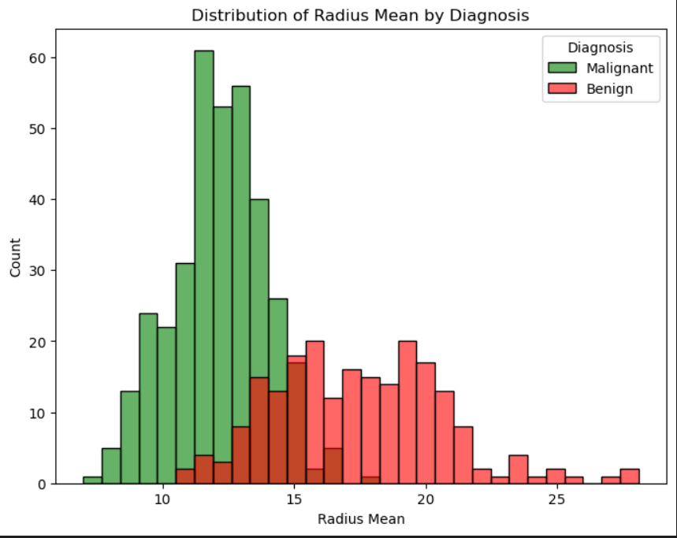
📊 What the Histogram Shows
Malignant tumors(green): tend to have lower radius mean values, clustering around the 5–15 range.
Benign tumors(red) :are more spread out and skewed toward higher radius mean values, often between 15–25.
There's a clear separation in the distributions, suggesting that radius mean is a strong indicator of tumor type.

Slide 12
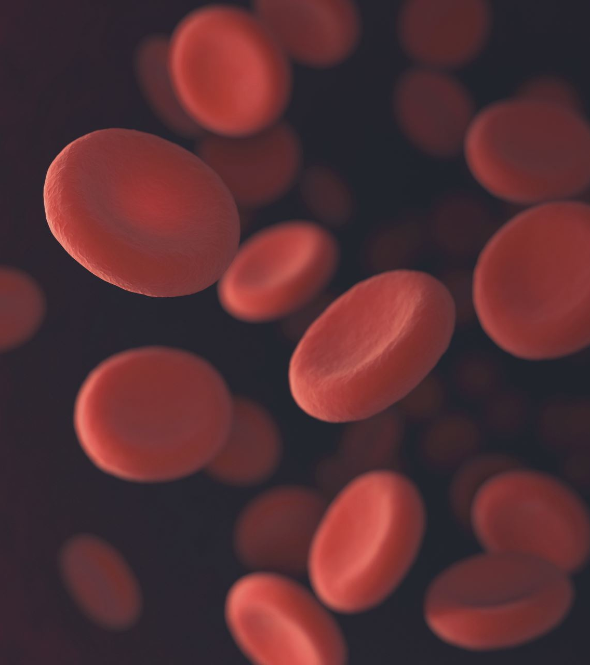
🧠 Clinical Insight
Tumor Size Matters
The radius mean reflects the average size of the tumor. Smaller tumors tend to be more suspicious when paired with other irregular features.
Malignant Tumors Skew Smaller
Malignant tumors in this dataset generally have lower radius mean values, suggesting that size alone can be an early red flag.
Benign Tumors Are Often Larger and More Uniform
Benign tumors show a wider spread and higher radius values, indicating they may grow larger but maintain more regular structure.
Example: Diagnostic Use in Practice
Suppose a patient’s scan shows a tumor with a radius mean of 12.5. Based on this distribution, and if other features like compactness and texture are also elevated, this tumor would lean toward the malignant profile and warrant further testing (e.g., biopsy or MRI).

Slide 13
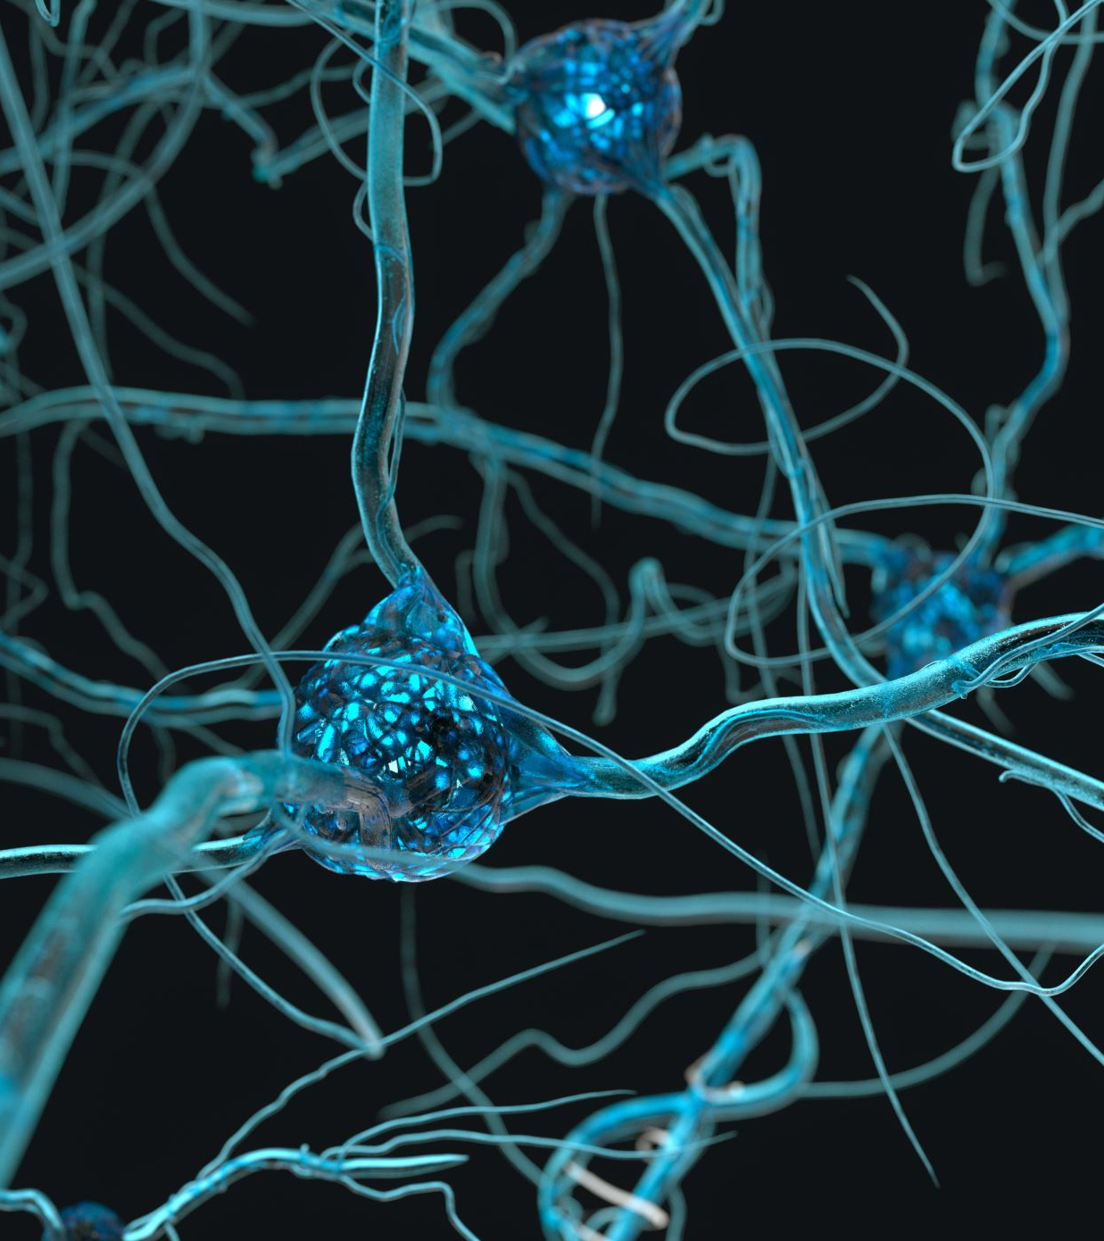
🧪Models we did
Think of it this way: we tested a few automated systems to help identify cancerous tumors.
Some systems (Decision Tree, Random Forest) were okay, but not the most reliable.
One system (Neural Network) was quite good at catching most cancerous tumors (high recall) and was generally accurate.
The best system we found was the SVM This system was the most accurate overall, and crucially, it was the best at two very important things for us:
It was excellent at not missing any cancerous tumors in our test (high recall).
It was perfect at not giving false alarms (perfect precision) – meaning when it said a tumor was cancerous, it was right every time in our test.
based on these results, the SVM model appears to be the most promising for helping to identify malignant breast tumors accurately and reliably, with a low risk of missing cancerous cases and no false alarms in our test.

Slide 14

🩺 Clinical Framing Advice
1) Think Like a Radiologist
Ask: “If I saw this tumor on a scan, what features would make me suspicious?” Use that mindset toprioritize features like texture, compactness, and symmetry.
2) Use Realistic Examples in Your Presentation
When sharing insights, include patient-like scenarios:
“A tumor with radius mean 13.2 and compactness0.15 falls into the malignant zone based on our analysis.”
This makes your work relatable and clinically grounded.
3) Highlight Diagnostic Value, Not Just Stats
Always connect the data back to clinical decisions. For example:
“This feature helps reduce false negatives in early detection.”
4) Iterate Like a Clinician
Refine your visualizations and models as if you're reviewing a patient’s evolving chart. Each iteration brings you closer to clarity and confidence.

